Slide 1

Thank you for waiting.
The webinar will begin shortly.

Slide 2



SSNAP Annual Report 2024
Stroke care received between
April 2023 and March 2024
Prof Martin James
SSNAP Clinical Director

Slide 3




Highlight metrics
1
Onset to hospital arrival time at first hospital (median)
7
Thrombectomy rate (all strokes)
2
Access to initial brain imaging within 20 minutes
8
90% stay on a stroke unit
3
9a
Access to stroke/neurology specific combined ESD-CRT service
Access to stroke unit within 4 hours
4
Assessment by stroke clinician within 1 hour
9b
Access to any stroke/neurology specific community rehabilitation service
5
Hyperacute interventions for intracerebral haemorrhage within 1 hour
10
Access to 6-month follow-up
6
Thrombolysis rate (all strokes)

Slide 4
Key messages
Reperfusion treatment rates have improved: the proportion of all patients receiving thrombolysis has increased from 10.7% in 2022/23 to 11.6% in 2023/24, and 3.9% of all patients received thrombectomy in 2023/24 compared to 3.1% in 2022/23.
1
2
The proportion of eligible patients receiving an appropriate hyperacute intervention has increased since SSNAP started collecting this data, from 18.9% in 2018/19 to 24.9% in 2023/24.
Timely access to specialist acute stroke care has partly recovered this year: 46.7% patients were directly admitted to a stroke unit within 4 hours in 2023/24 compared to 40.2% in 2022/23, and 75.9% patients spent at least 90% of their stay on a stroke unit in 2023/24 compared to 72.8% in 2022/23.
3
The transition to integrated, needs-based community stroke services continues with 47.5% of community providers identifying as a combined ESD-CRT services. 63.4% of patients were discharged to an ESD and/or CRT service in 2023/24 compared to 40.7% in 2013/14.
4
5
Personalised review of people with stroke 6 months after the event remains patchy and is only available to a minority of stroke survivors, with 39% of applicable patients receiving a 6-month review.

Slide 5
11 years of SSNAP

Slide 6
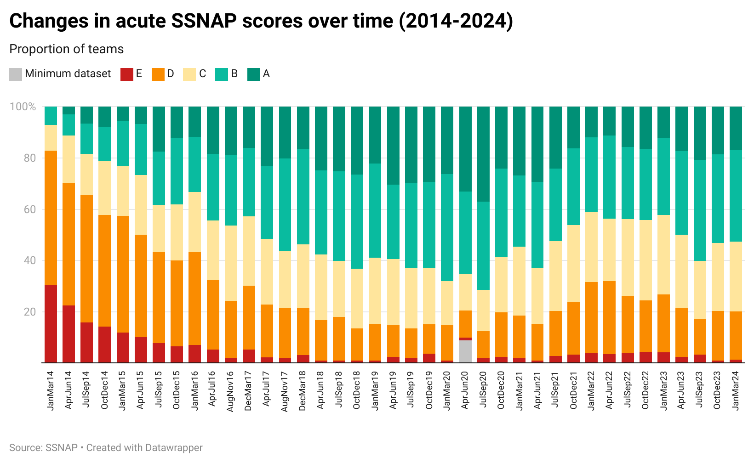

Slide 7
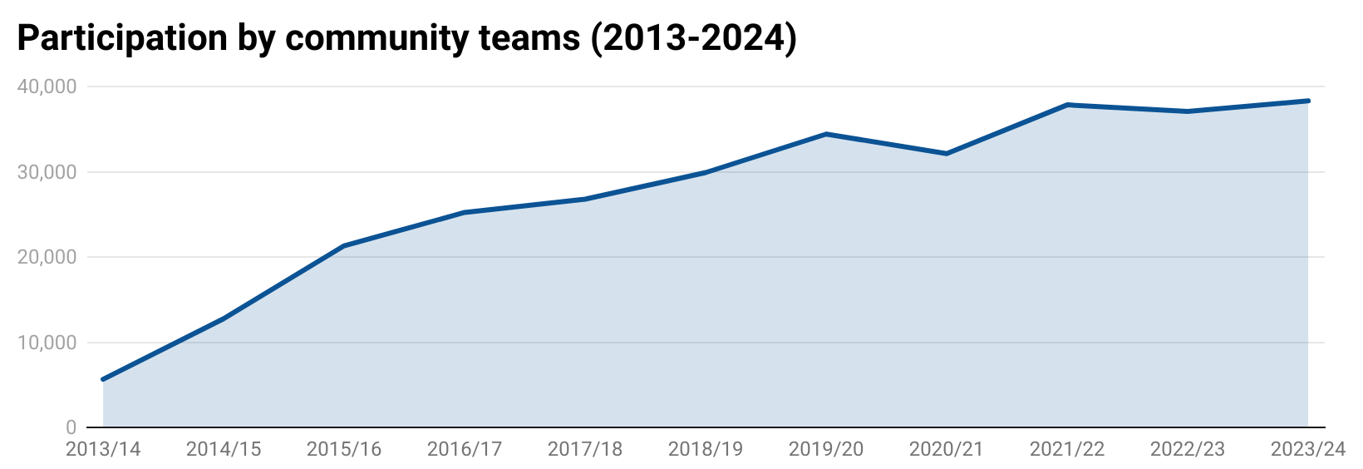

Slide 8

Pre-hospital care

Slide 9
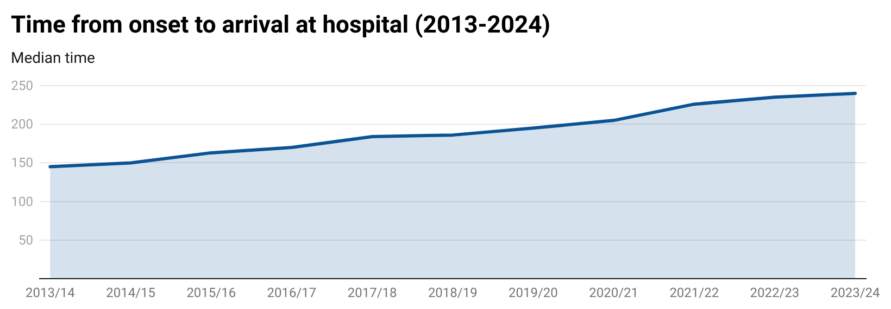

Slide 10
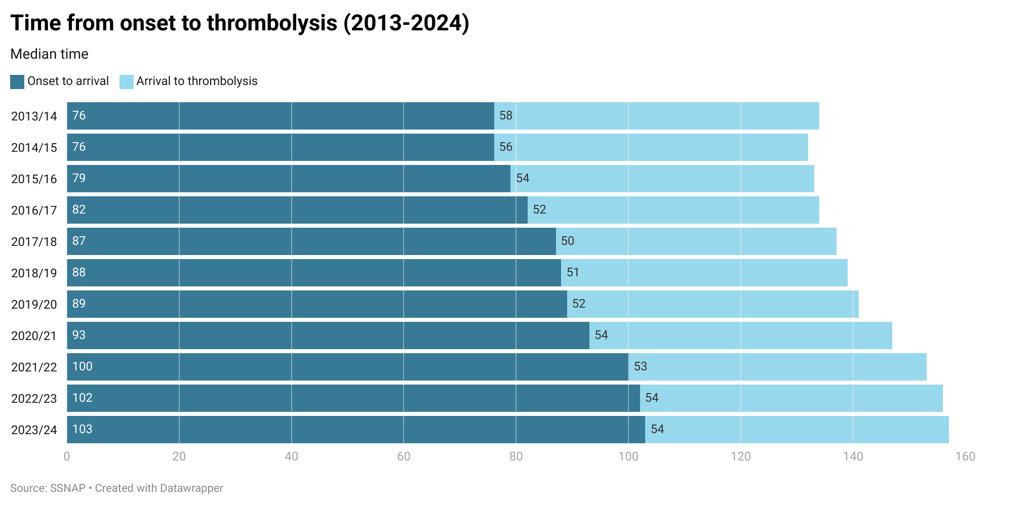


Slide 11
Reperfusion treatment

Slide 12
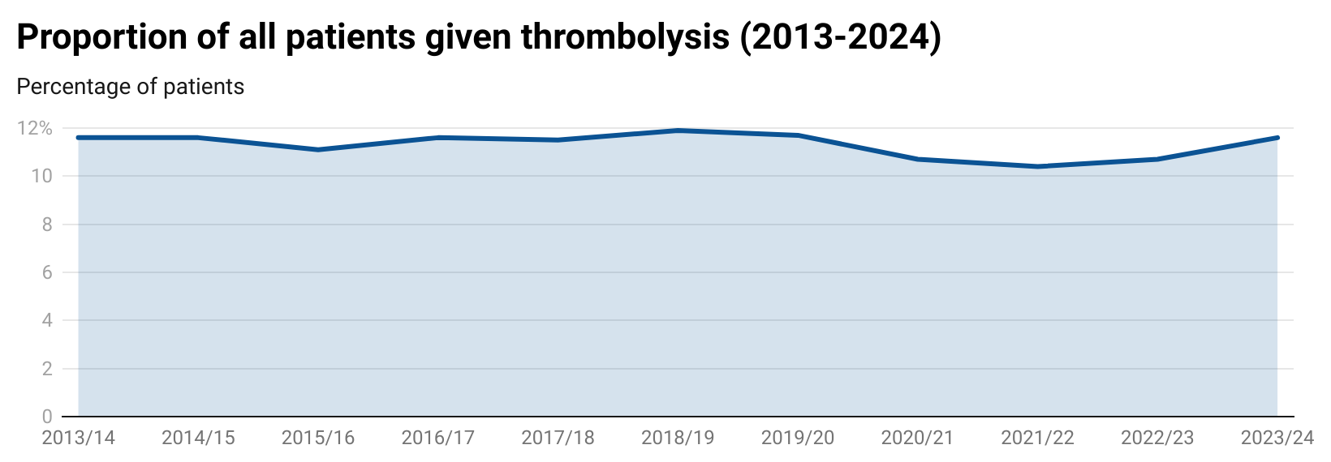
11.6%

Slide 13
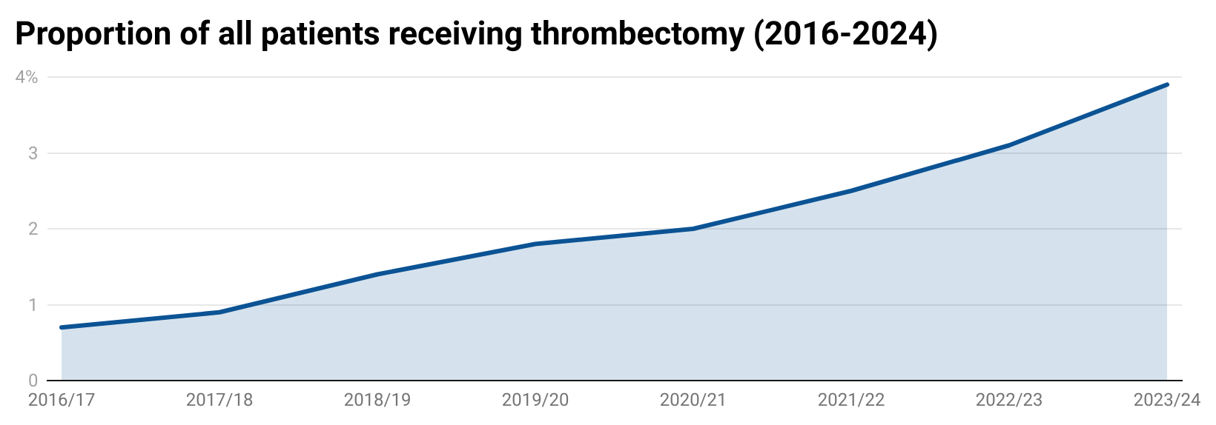
3.9%
(+30%)

Slide 14
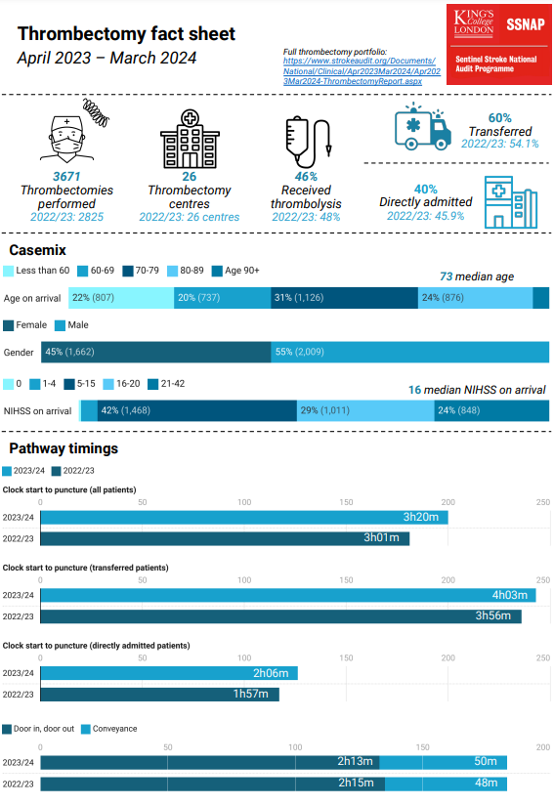
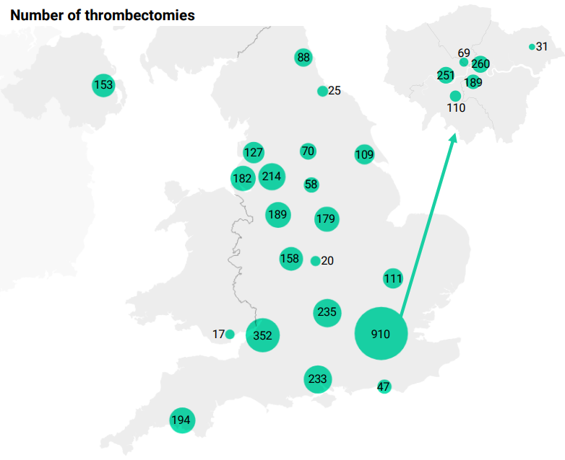


Slide 15

How is SSNAP changing to reflect the new evidence?
Domain 3: Reperfusion
3.1 Percentage of all stroke patients given thrombolysis
3.2 Percentage of stroke patients with extended indications for thrombolysis given thrombolysis
3.3 Percentage of stroke patients given thrombolysis (within 4h) compared with bespoke site-specific target
3.4 Median time between clock start and thrombolysis (hours:mins)
3.5 Percentage of all patients given thrombectomy
3.6 Median time between arrival and discharge at first admitting team (door-in-door-out) for patients receiving thrombectomy (hours:mins)
3.7 Median time between arrival at thrombectomy centre and arterial puncture (door to puncture) (hours:mins)
Revised in-hospital dataset introduced from 01 October 2024
Includes new indications for imaging, IVT and MT from the 2023 National Clinical Guideline for the UK and Ireland
Replaces the old ‘RCP Criteria’ key indicator with a new, bespoke site-specific IVT target derived by the SAMueL method (i.e. based on each site’s own patients)
First KI reports to sites in Feb 2025, scoring in May 2025 and publicly available SSNAP scores from August 2025
So GET READY for the SSNAP scoring update!

Slide 16
Intracerebral haemorrhage

Slide 17
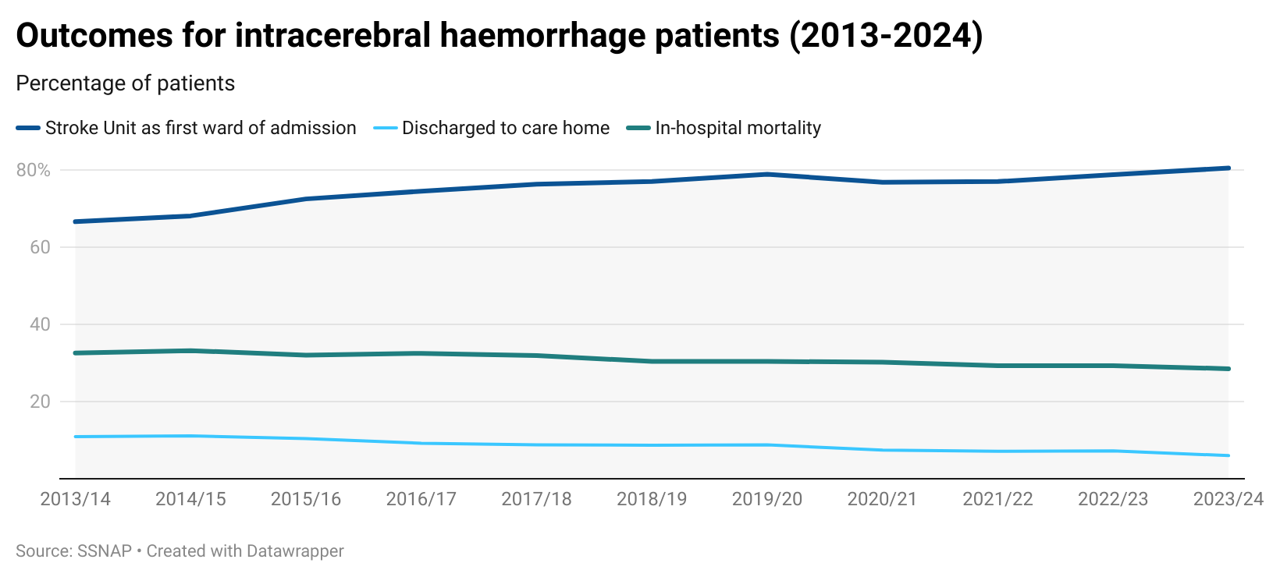

Slide 18
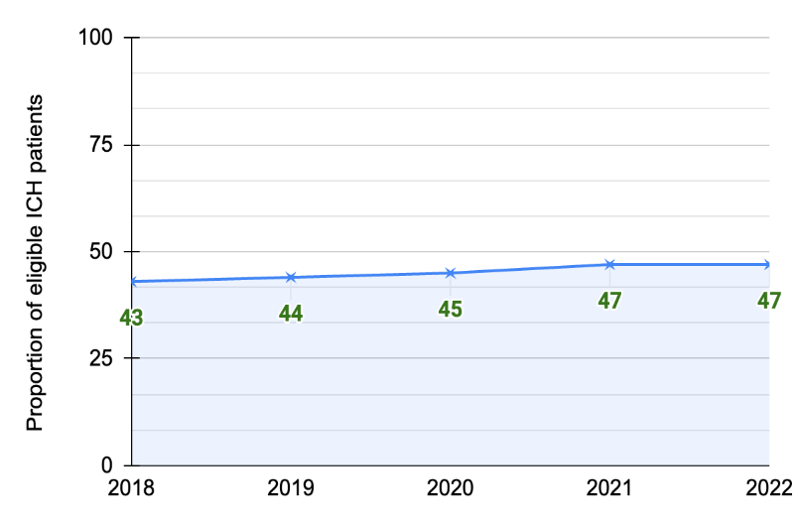
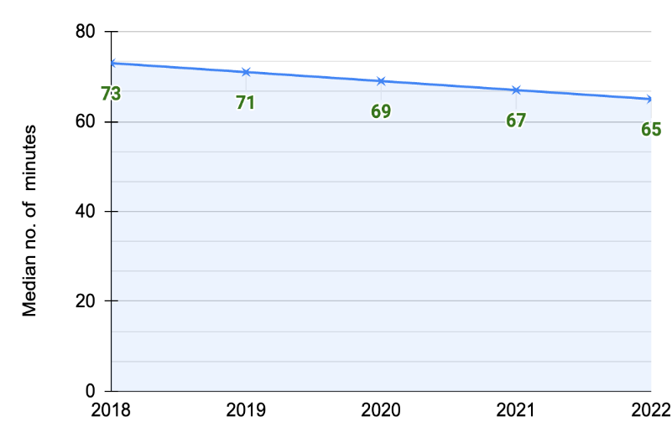
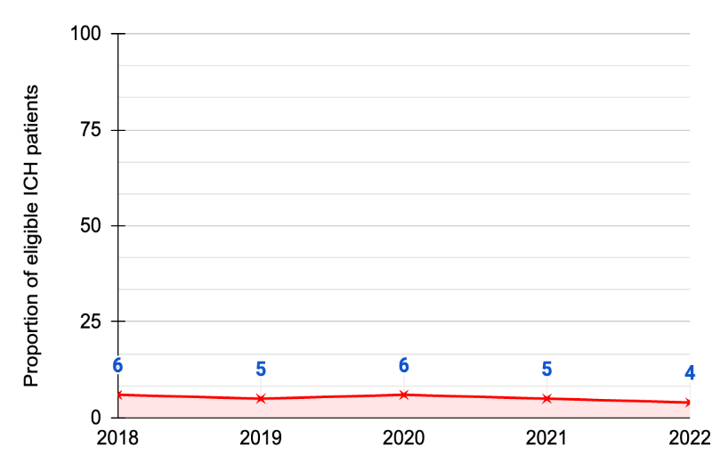
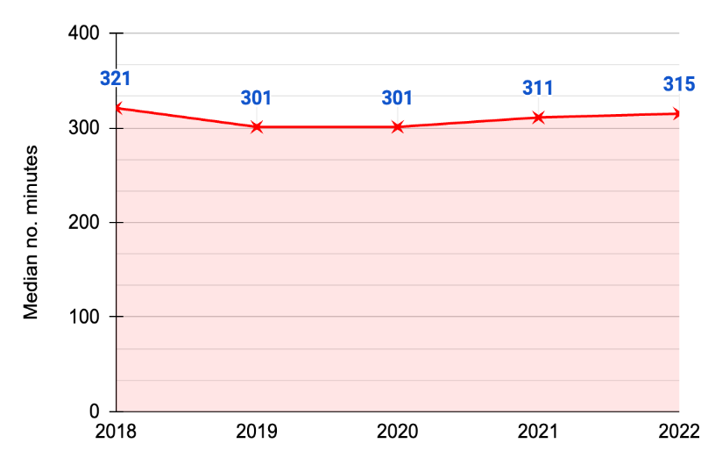

Guideline-based treatment for ICH?
Figure 2: Proportion of eligible ICH patients receiving BPRx within 1hr of arrival
Figure 3: Median time from arrival to BPRx received for eligible ICH patients
Figure 4: Proportion of ICH patients achieving target sysBP within 1hr of arrival
Figure 5: Median time from arrival to target sysBP achieved for eligible ICH patients treated
Holloway et al, World Stroke Congress, Toronto 2023

Slide 19
Access to specialist stroke care

Slide 20
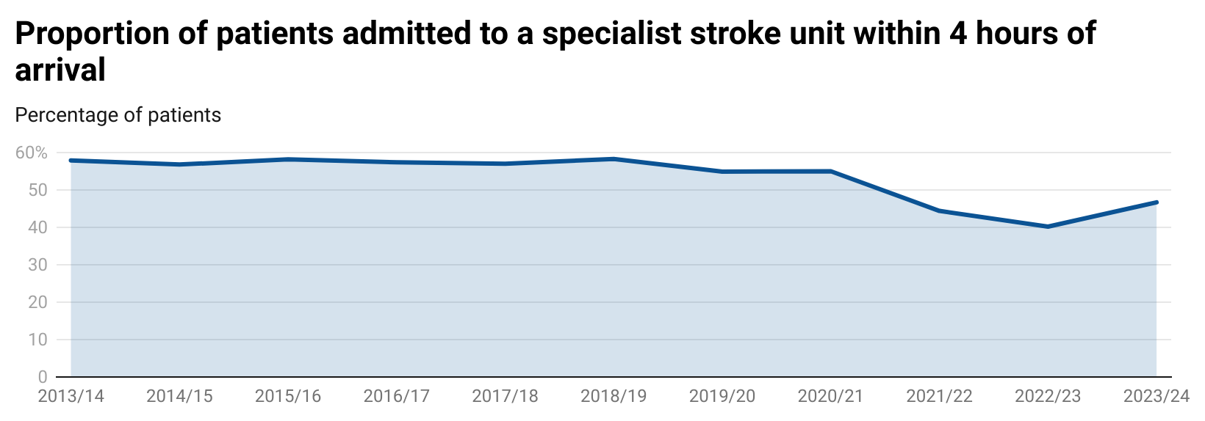
46.7%

Slide 21
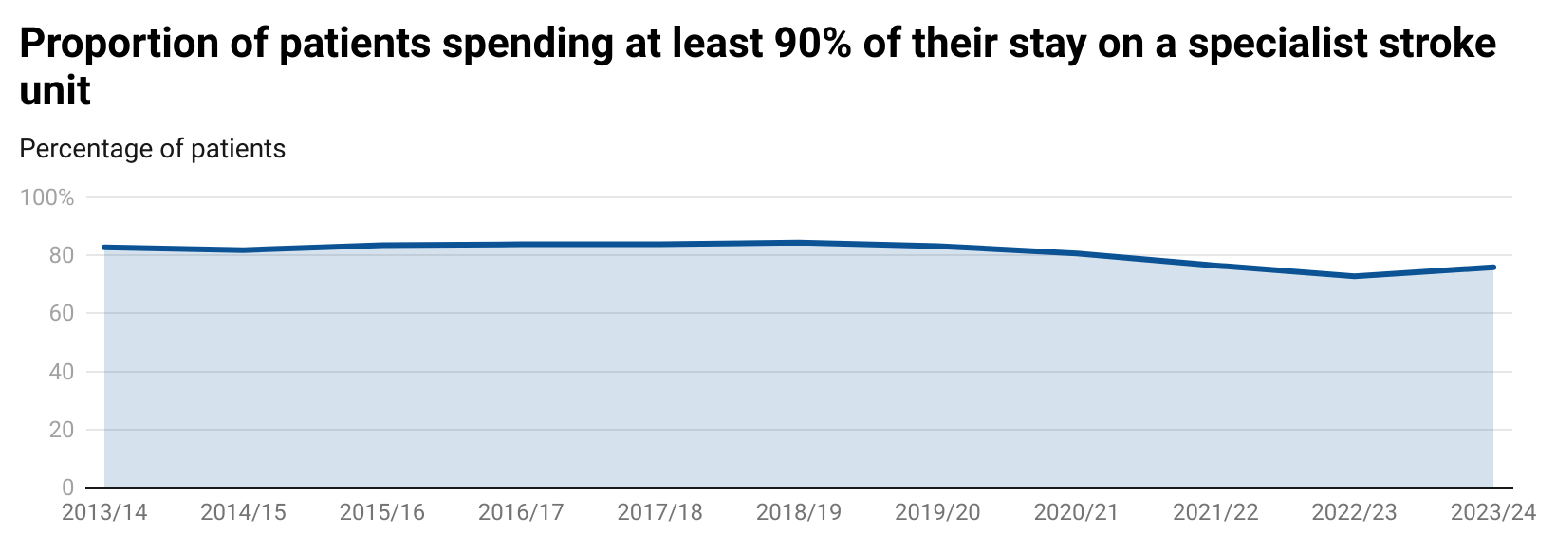
75.9%

Slide 22
How is SSNAP changing to reinforce the old evidence?
Domain 2: Specialist Pathway
2.1 Percentage of patients directly admitted to a stroke unit within 4 hours of clock start
2.2 Median time between clock start and arrival on stroke unit (hours:mins)
2.3 Percentage of patients who spent at least 90% of their stay on stroke unit
2.4 Percentage of patients treated by a stroke specialist community rehabilitation team (ESD, CRT or combined)
Revised Key Indictor set introduced for the new dataset from 01 October 2024
Includes just four Key Indicators in Domain 2 ‘Specialist Pathway’
Double-weighting to reinforce the pivotal role of the specialist pathway
First KI reports to sites in Feb 2025, scoring in May 2025 and publicly available SSNAP scores from August 2025
So GET READY for the SSNAP scoring update!

Slide 23
Inpatient rehabilitation

Slide 24
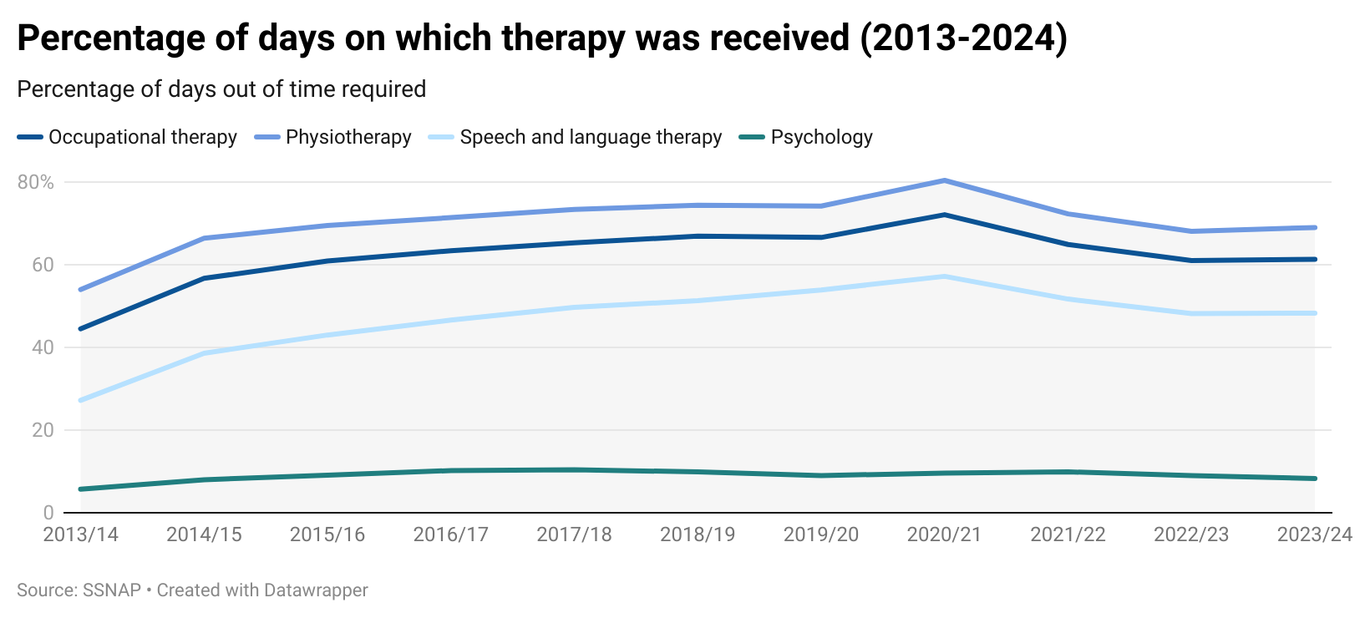

Slide 25
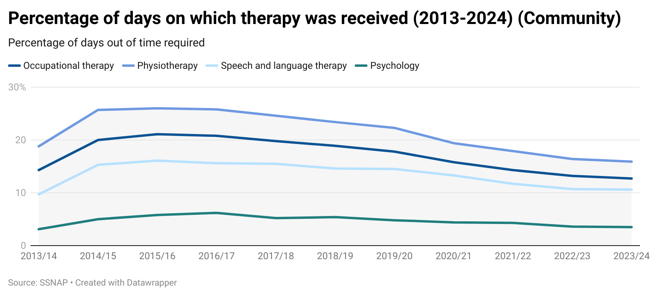

Slide 26
Community rehabilitation

Slide 27
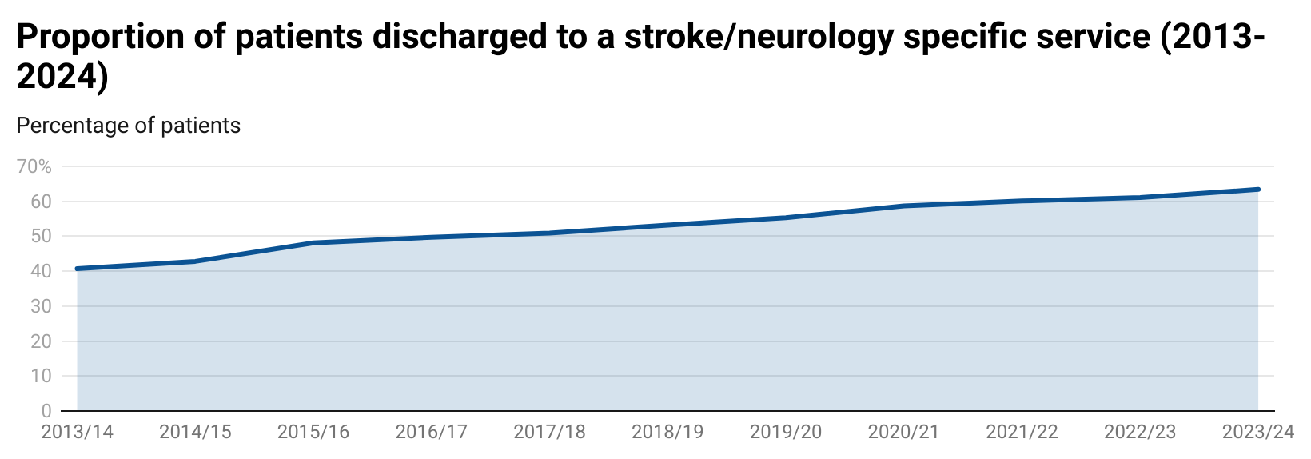

Slide 28
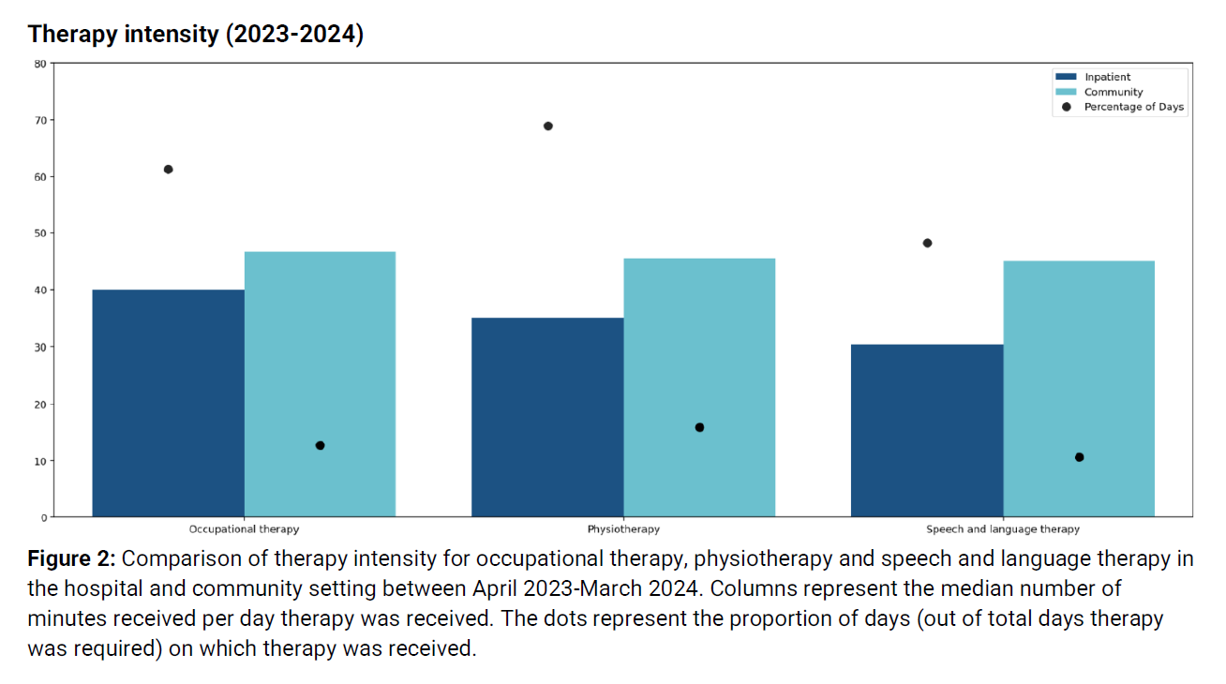
Therapy Spotlight Report 2023-24
SSNAP Therapy spotlight report 2023-2024

Slide 29
How is SSNAP changing?
How is SSNAP changing to reflect the new evidence?
Domain 5: Therapy intensity
5.1 Percentage of applicable patients who are assessed by a nurse within 4 hours AND occupational therapist and physiotherapist within 24 hours AND speech and language therapist within 72 hours AND have rehab goals agreed within 5 days
5.2 Percentage of patients achieving the NICE target for total therapy dose received
5.3 Median number of minutes of total therapy received per day the patient is an inpatient
Domain 6: Therapy frequency
6.1 Percentage of patients receiving 3 hours of motor therapy per day motor therapy received
6.2 Median percentage of days as an inpatient on which motor therapy is received
6.3 Percentage of patients receiving 45 minutes of psychological therapy per day psychological therapy received
6.4 Median percentage of days as an inpatient on which psychological therapy is received
6.5 Percentage of patients receiving 45 minutes of communication/swallowing therapy per day communication/swallowing therapy received
6.6 Median percentage of days as an inpatient on which communication/swallowing therapy is received
Revised in-hospital dataset introduced from
01 October 2024
Significant weight given to the NICE ‘total rehab’ target in Domain 5 ‘Therapy Intensity’
UK NCG23 targets (3hrs motor therapy, 45 mins cognitive/ psychological and speech therapy) in Domain 6 ‘Therapy Frequency’
First KI reports to sites in Feb 2025, scoring in May 2025 and publicly available SSNAP scores from August 2025
So GET READY for the SSNAP scoring update!

Slide 30
6-month follow up

Slide 31
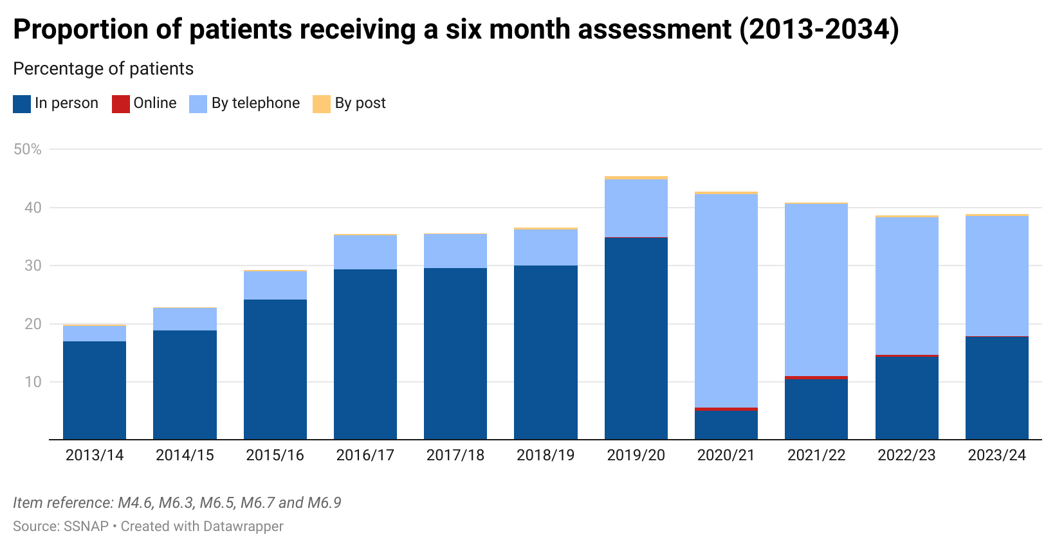

Slide 32
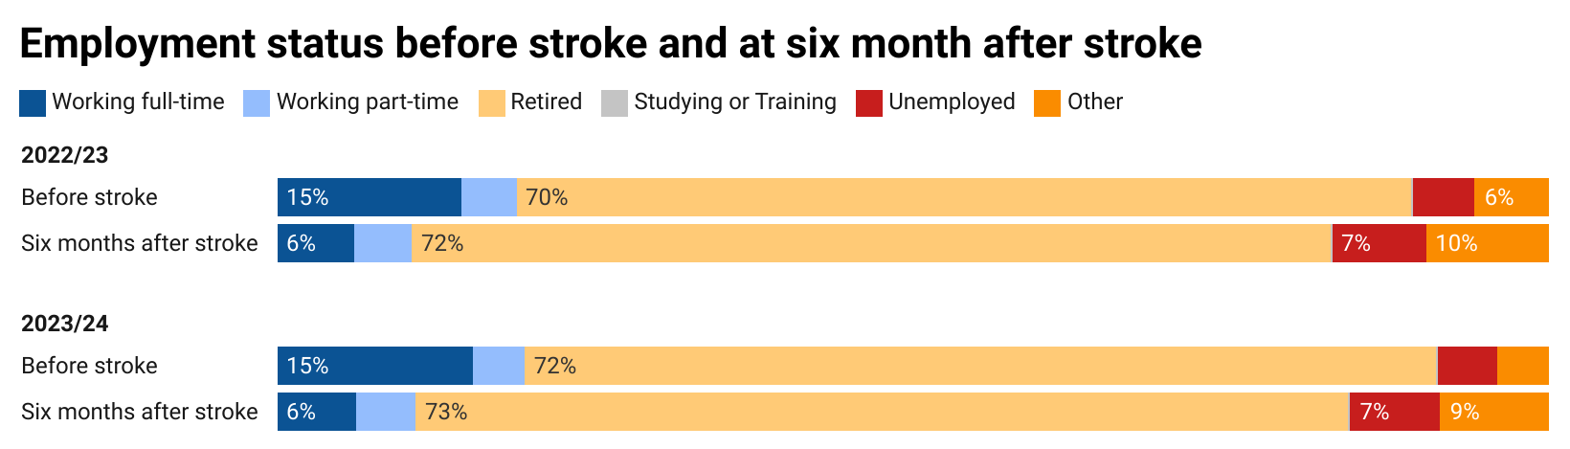
SSNAP Outcomes spotlight report 2023-2024

Slide 33
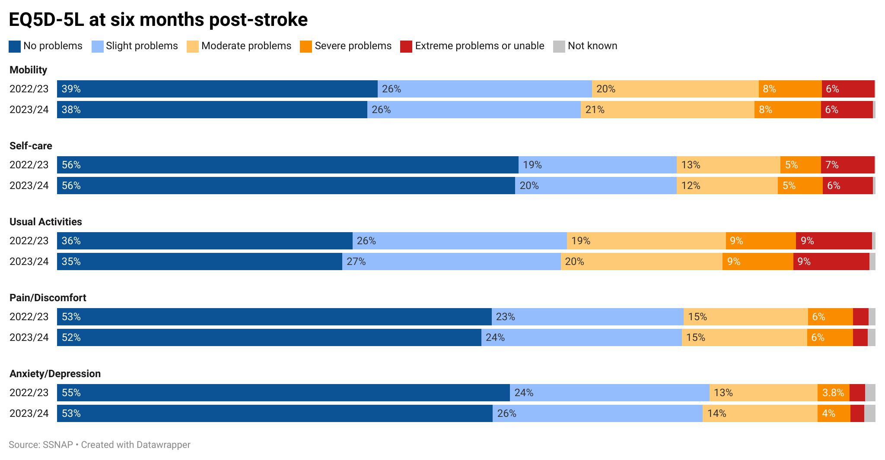
SSNAP Outcomes spotlight report 2023-2024

Slide 34
National recommendations
Collaborate in regional networks to reduce the time from stroke onset to hospital and subsequently to specialist care on a stroke unit. For action by: Integrated Stroke Delivery Networks (ISDNs) and Local Health Boards (LHBs).
1
Increase the proportion of patients receiving the appropriate imaging immediately on arrival at hospital, to accelerate the identification of patients eligible for hyperacute interventions. For action by: ISDNs, LHBs and Regional Radiology Networks.
2
3
Restore timely access to hyperacute specialist inpatient care for stroke. For action by: Integrated Care Boards (ICBs) and LHBs.
Support the shift to leaving hospital much sooner and at an earlier stage in rehabilitation by providing equitable access to needs-based integrated 7-day rehabilitation along the whole pathway. For action by: ICBs and LHBs.
4
Respond to the need for ongoing support and regular review when recovering from the life-changing effects of acute stroke and ensure that all stroke survivors receive formal follow-up 6 months after their stroke, with further support made available for those identified with ongoing needs. For action by: ICBs and LHBs.
5

Slide 36
Any questions?

