Slide 1
SSNAP Annual Report 2023
Stroke care received between April 2022 and March 2023
Dr Ajay Bhalla
SSNAP Associate Clinical Director

Slide 2
Key messages
The proportion of patients accessing timely specialist stroke care continues to decline: 40.2% patients directly admitted to a stroke unit within 4 hours in 2022/23 compared to 44.4% in 2021/22, and 72.9% patients spending at least 90% of their stay on a stroke unit in 2022/23 compared to 76.5% in 2021/22. These figures compare to 54.9% and 83.2% respectively for 2019/20.
1
Reperfusion treatment rates have improved: the proportion of all patients receiving thrombolysis has increased from 10.4% in 2021/22 to 10.7% in 2022/23, and 3.1% of all patients have received thrombectomy in 2022/23 compared to 2.5% in 2021/22.
2
Intracranial haemorrhage patients now have better access to specialist care (76% patients directly admitted to a stroke unit in 2022 compared to 66% in 2013), which is associated with reduced in-hospital mortality rates compared with 10 years ago (29% in 2022 compared to 33% in 2013).
3
The transition to integrated community stroke services has begun with 49% of community providers now identifying as a combined ESD-CRT service. 61% of patients were discharged to an ESD (Early Supported Discharge) and/or CRT (Community Rehabilitation Team) service in 2022/23 compared to 40.7% in 2013/14.
4
5
SSNAP now collects data on return to work at 6 months after a stroke. The proportion of patients working full-time 6 months after stroke is 6.1% compared to 14.5% working full-time before stroke.

Slide 3
National recommendations
1
Reverse the recent decline in hyperacute specialist access for stroke. For action by: Acute trusts, Local Health Boards (LHBs), Regional Medical Directors (RMDs) and Integrated Stroke Delivery Networks (ISDNs).
Increase the proportion of patients receiving the appropriate imaging immediately on arrival at hospital, to accelerate the identification of patients eligible for reperfusion treatments. For action by: Acute trusts, LHBs, RMDs, Radiology Networks and ISDNs.
2
3
Increase the proportion of days on which people recovering from stroke receive rehabilitation therapy, both inside and outside hospital. For action by: Acute and community trusts and LHBs.
4
Increase the proportion of patients accessing stroke/neuro ESD and/or CRT. For action by: LHBs, acute and community trusts, supported by ISDNs and regional SQuIRe (Stroke Quality Improvement Rehabilitation) leads.
Reverse the recent decline in the proportion of stroke survivors who receive formal follow-up 6 months after their stroke. For action by: Acute and community trusts and Integrated Care Board (ICB) and LHB commissioners, supported by ISDNs and regional SQuIRe leads.
5

Slide 4
10 years of SSNAP

Slide 7
Pre-hospital timings

Slide 8
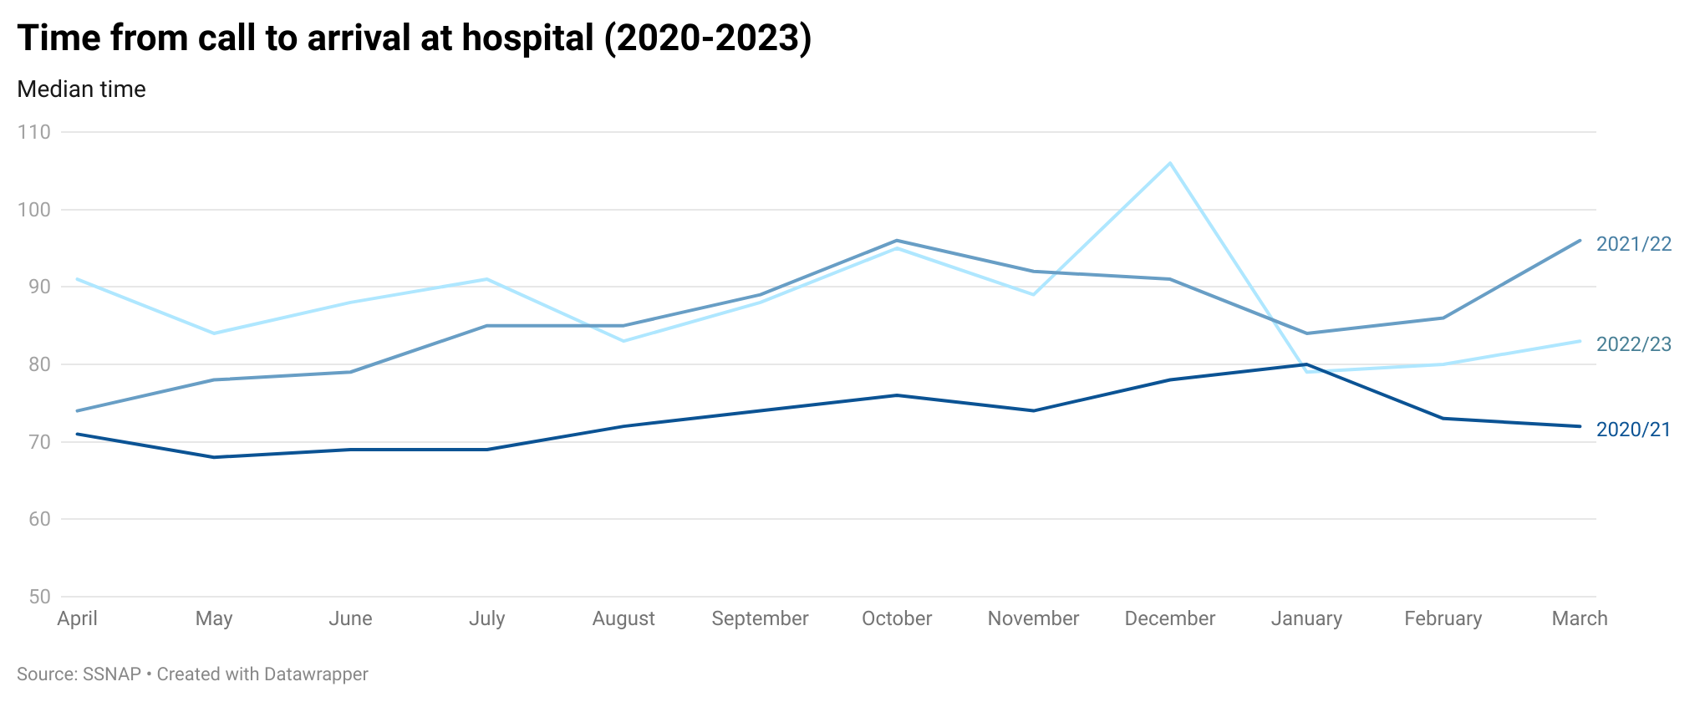

Slide 9
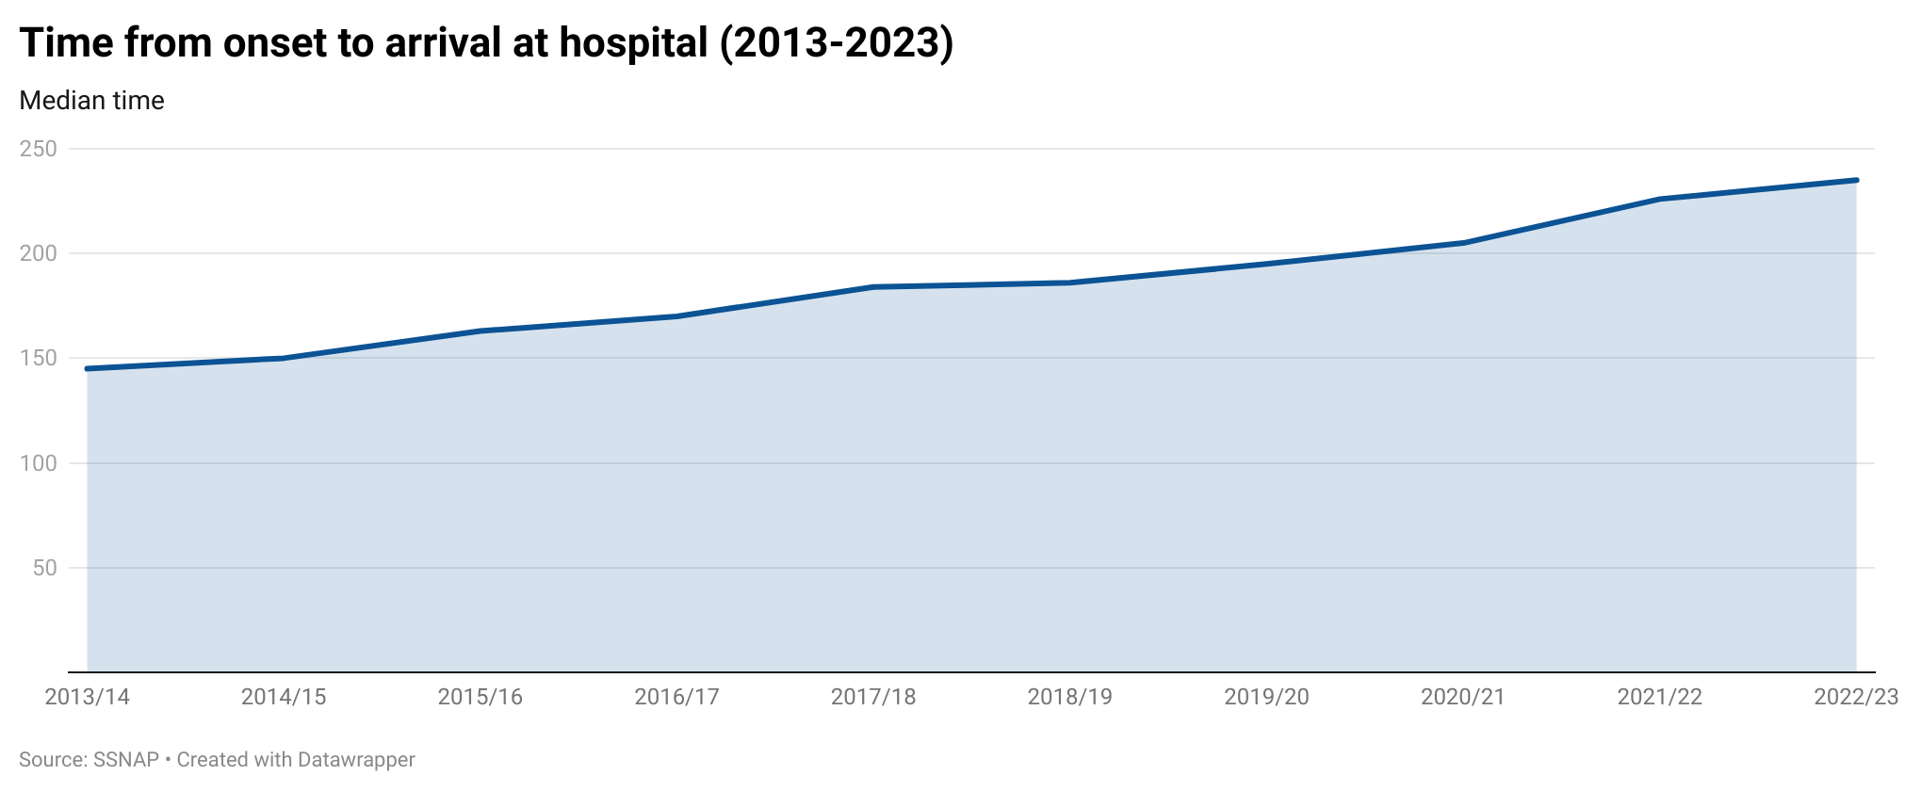

Slide 10
Reperfusion treatment

Slide 11
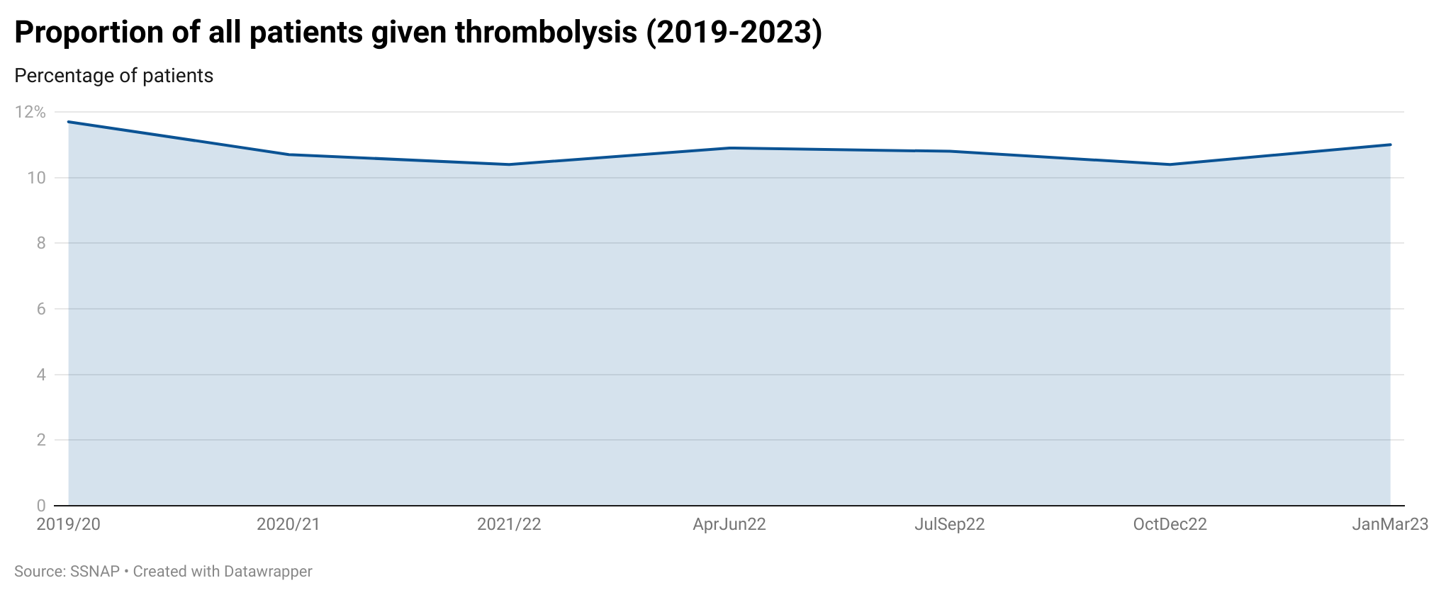

Slide 12
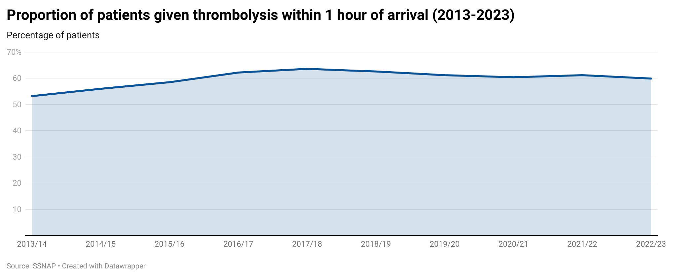

Slide 13
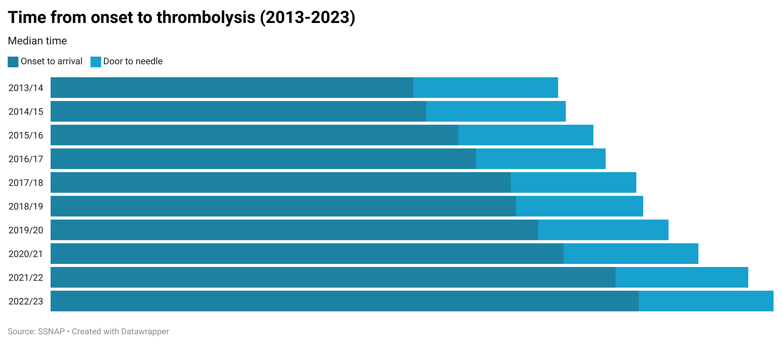

Slide 15
Intracerebral haemorrhage

Slide 17
Access to specialist stroke care

Slide 21
Inpatient rehabilitation

Slide 23
Community rehabilitation

Slide 26
6 month follow-up

Slide 29
Any questions?

